Slide 1
Pivotal Cloud Foundry
Jan 2017

Slide 2
PCF -DAY 02

Slide 3
Configuring the Deployed applications (TBD)
CF Logs
CF start
CF stop

Slide 4
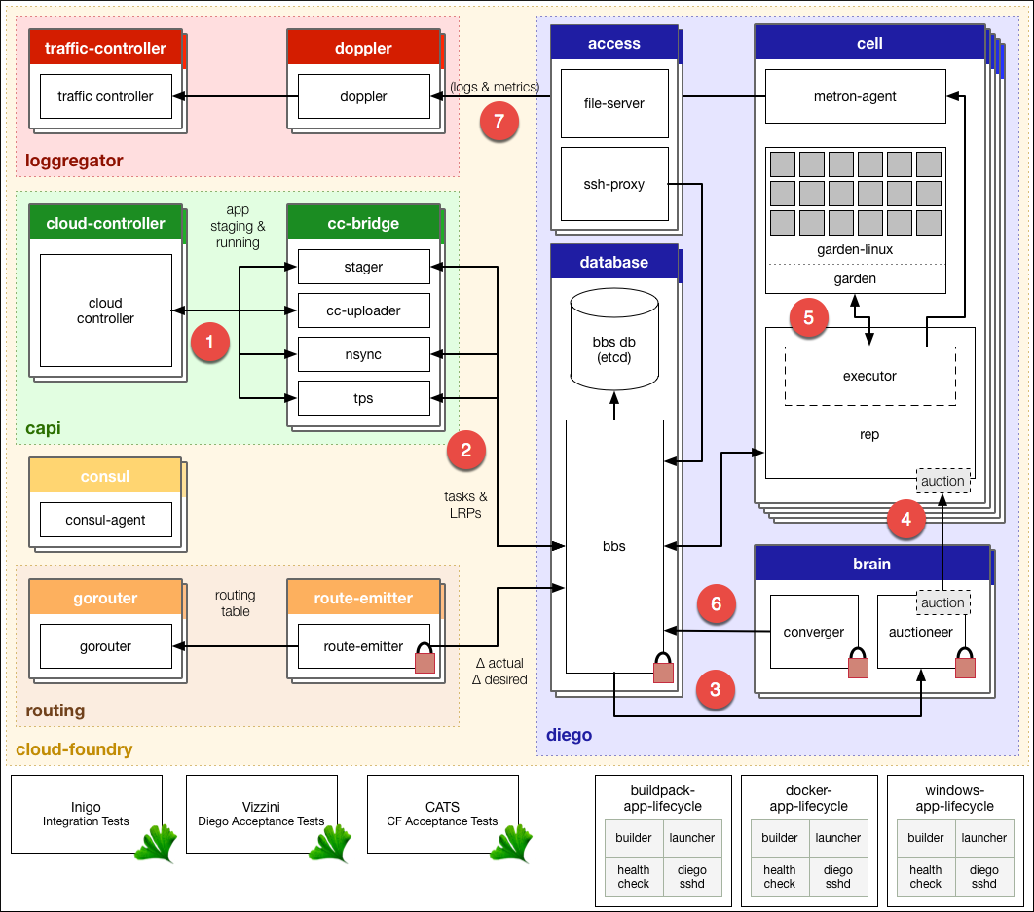
Diego Architecture

Slide 5
Diego Architecture
The Cloud Controller passes requests to stage and run applications to the Cloud Controller Bridge (CC-Bridge).
The CC-Bridge translates staging and running requests into Tasks and Long Running Processes(LRPs), then submits these to the Bulletin Board System (BBS) through an API over HTTP.
The BBS submits the Tasks and LRPs to the Auctioneer part of the Diego Brain.
The Auctioneer distributes these Tasks and LRPs to Cells through an Auction. The Diego Brain communicates with Diego Cells using SSL/TLS protocol.
Once the Auctioneer assigns a Task or LRP to a Cell, an in-process Executor creates a Garden container in the Cell. The Task or LRP runs in the container.
The BBS tracks desired LRPs, running LRP instances, and in-flight Tasks. It also periodically analyzes this information and corrects discrepancies to ensure consistency between ActualLRP and DesiredLRP counts.
The Metron Agent, part of the Cell, forwards application logs, errors, and metrics to the Cloud Foundry Loggregator. For more information, see the Application Logging in Cloud Foundry topic.

Slide 6
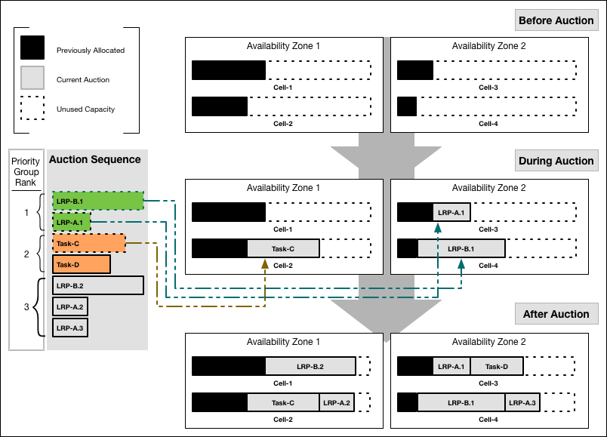
Job Allocation
Notes:
Our example auction sequence has seven jobs: five LRP instances and two Tasks. The above shown diagram shows how the Auctioneer might distribute this work across four Cells running in two Availability Zones:

Slide 7
Metrics and Logging
Loggregator (log aggregator)
Loggregator is the next generation system for aggregating and streaming logs and metrics from all of the user apps and system components in an Elastic Runtime deployment.
The Loggregator system streams application logs to developers for many purposes.
You can configure Elastic Runtime to forward log data from components and apps to an external aggregator service instead of routing it to the Loggregator Firehose.
Use cases of Loggregator :
App developers can tail their application logs or dump the recent logs from the CF CLI, or stream these to a third party log archive and analysis service.
Operators and administrators can access the Loggregator Firehose, the combined stream of logs from all apps, plus metrics data from CF components.
Operators can deploy ‘nozzles’ to the Firehose. A nozzle is a component that listens to the Firehose for specified events and metrics and streams this data to external services.

Slide 8
Restart/Restage
Restart Your Application
Restarting your application stops your app and starts it with the already compiled droplet
cf restart <YOUR-APP>
Restart your application to refresh the application’s environment after actions such as binding a new service to the app or setting an environment variable that only the app consumes.
Restage Your Application
Restaging your application stops your application and restages it, by compiling a new droplet and starting it.
cf restage< YOUR-APP>
Restage your application if you have changed the environment in a way that affects your staging process, such as setting an environment variable that the buildpack consumes.
Note:
Restaging your application compiles a new droplet from your application without updating your application source. If you need to update your application source, re-push your application

Slide 9
Services
Cloud Foundry offers a marketplace of services, from which users can provision reserved resources on-demand
These resources are known as service instances and the systems that deliver and operate these resources are known as Services.

Slide 10
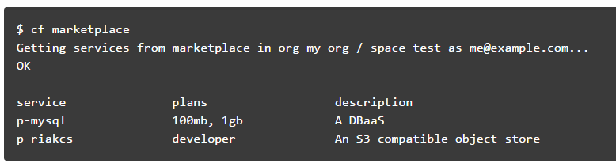
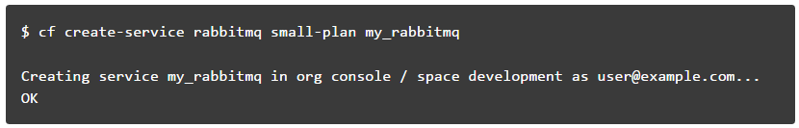
Manage Service Instances with the CLI
List Marketplace Services
Creating Service Instances
create a service instance with the command;
cf create-service <SERVICE> <PLAN> <SERVICE_INSTANCE>
Notes:
For a service to be available in the marketplace, it must be integrated with Cloud Foundry by way of APIs.

Slide 11
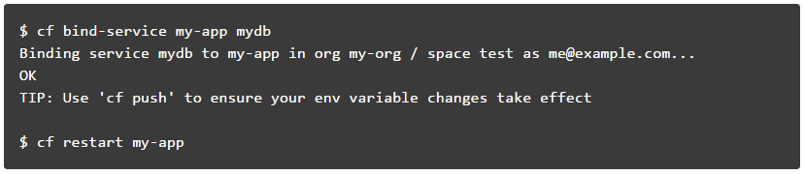
Manage Service Instances with the CLI
Bind a Service Instance
binding a service instance to an application after pushing an application
Binding a service with Application Manifest
Alternatively, a service instance can be bind to an app after pushing an application, you can use the application manifest to bind the service instance during push
Manifest.yml
services:
- test-mysql-01

Slide 12
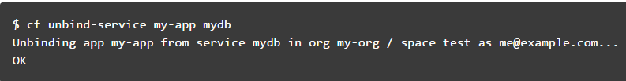
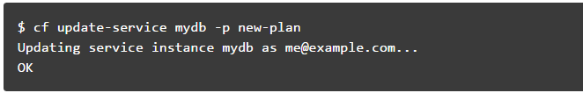
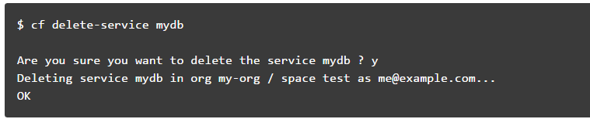
Manage Service Instances with the CLI
Unbind a Service Instance
Unbinding a service instance from an application removes the credentials created for your application from the VCAP_SERVICES environment variable.
Update a Service Instance
If any service plan needs to be updated to your service instance, then cf update-service can be performed,
Delete a service Instance
Notes:
Note: You must restart or in some cases re-push your application for changes to be applied to the VCAP_SERVICES environment variable and for the application to recognize these changes.

Slide 13
User-Provided Service Instances
Cloud Foundry enables users to leverage services that are not available in the marketplace using a feature called User-Provided Service Instances (UPSI).
User-Provided Service Instances
Use (alias cf cups) creates a new service instance.
E.g. cf cups sql-service-instance -p "host, port, dbname, username, password“
To create a service instance that sends data to a third-party.
Use the -l option followed by the external destination URL.
E.g. cf cups mylog -l syslog://logs4.example.com:25258
Use (alias cf uups) to update a existing service instance.
E.g. cf uups sql-service-instance -p "host, port, dbname, username, password“

Slide 14
Scaling an Application
Factors such as user load, or the number and nature of tasks performed by an application, can change the disk space and memory the application uses. For many applications, increasing the available disk space or memory can improve overall performance
Scaling :
Running additional instances of an application can allow the application to handle increases in user load and concurrent requests.
Scaling Horizontally
cf scale myApp -i 5
Scaling Vertically
cf scale myApp -k 512M
cf scale myApp -m 1G

Slide 15
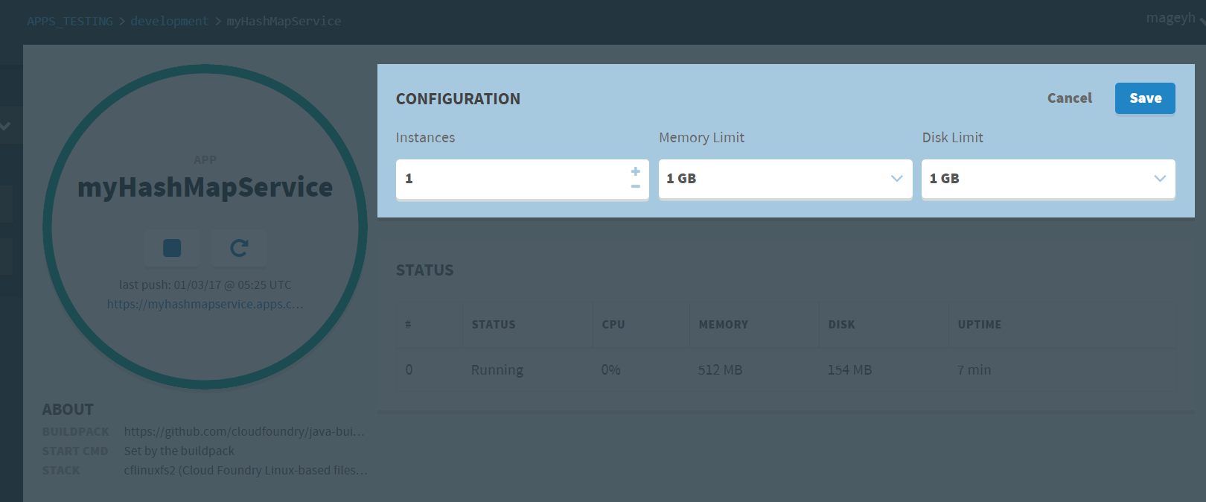
Scaling an Application

Slide 16
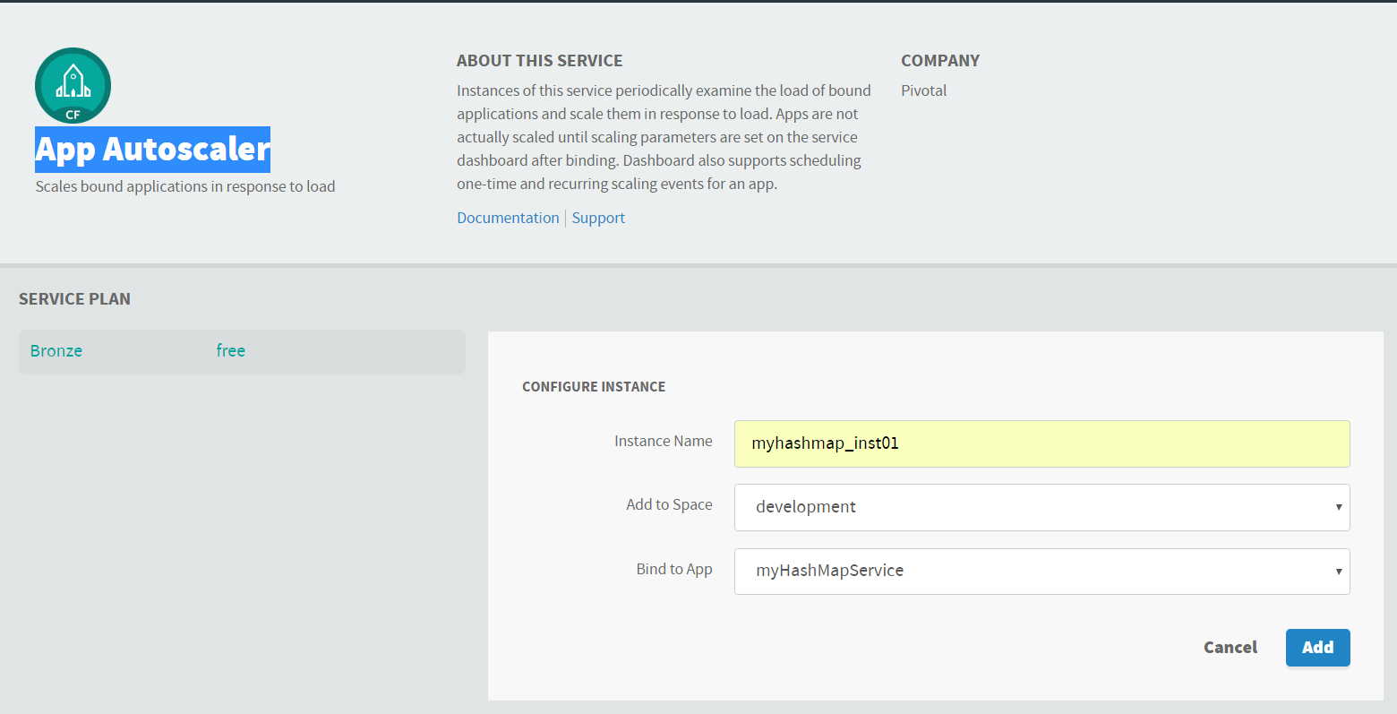
Scaling an Application
Configure Autoscaling for an App
Autoscaler keeps instance counts within an allowable range defined by minimum and maximum values, or instance limits.
Instance Limits
Scaling Rules
Scheduled Limit Changes
Configure Autoscaling for an App
Creating Autoscalar instance and binding to an App

Slide 17
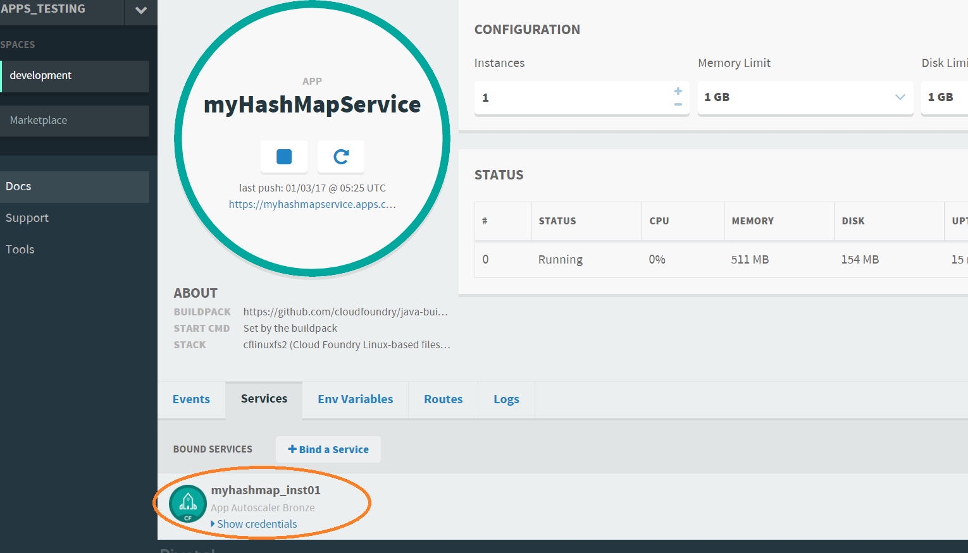
Scaling an Application
Configuring Autoscaler instance to an App

Slide 18
Lab 02

